Slide 1
Chapter 2
CS435: Introduction to Software Engineering
Dr. M. Zhu
Process Models
Software Engineering: A Practitioner’s Approach, 7/e
by Roger S. Pressman
Slides copyright © 1996, 2001, 2005, 2009 by Roger S. Pressman
Software Engineering 9/e
By Ian Sommerville
1
These slides are designed and adapted from slides provided by Software Engineering: A Practitioner’s Approach, 7/e (McGraw-Hill 2009) by Roger Pressman and Software Engineering 9^{/e} Addison Wesley 2011 by Ian Sommerville

Slide 2
Social Learning Process
Software is embodied knowledge that is initially dispersed, tacit and incomplete.
In order to convert knowledge into software, dialogues are needed between users and designers, between designers and tools to bring knowledge into software.
Software development is essentially an iterative social learning process, and the outcome is “software capital”.

Slide 3
What / who / why is Process Models?
What: Go through a series of predictable steps--- a road map that helps you create a timely, high-quality results.
Who: Software engineers and their managers, clients also. People adapt the process to their needs and follow it.
Why: Provides stability, control, and organization to an activity that can if left uncontrolled, become quite chaotic. However, modern software engineering approaches must be agile and demand ONLY those activities, controls and work products that are appropriate.
What Work products: Programs, documents, and data
What are the steps: The process you adopt depends on the software that you are building. One process might be good for aircraft avionic system, while an entirely different process would be used for website creation.
How to ensure right: A number of software process assessment mechanisms that enable us to determine the maturity of the software process. However, the quality, timeliness and long-term viability of the software are the best indicators of the efficacy of the process you use.

Slide 4
Definition of Software Process
A framework for the activities, actions, and tasks that are required to build high-quality software.
SP defines the approach that is taken as software is engineered.
Is not equal to software engineering, which also encompasses technologies that populate the process– technical methods and automated tools.

Slide 5

A Generic Process Model

Slide 6
A Generic Process Model
As we discussed before, a generic process framework for software engineering defines five framework activities-communication, planning, modeling, construction, and deployment.
In addition, a set of umbrella activities- project tracking and control, risk management, quality assurance, configuration management, technical reviews, and others are applied throughout the process.
Next question is: how the framework activities and the actions and tasks that occur within each activity are organized with respect to sequence and time? See the process flow for answer.

Slide 7

Process Flow

Slide 8
Process Flow
Linear process flow executes each of the five activities in sequence.
An iterative process flow repeats one or more of the activities before proceeding to the next.
An evolutionary process flow executes the activities in a circular manner. Each circuit leads to a more complete version of the software.
A parallel process flow executes one or more activities in parallel with other activities ( modeling for one aspect of the software in parallel with construction of another aspect of the software.

Slide 9
Identifying a Task Set
Before you can proceed with the process model, a key question: what actions are appropriate for a framework activity given the nature of the problem, the characteristics of the people and the stakeholders?
A task set defines the actual work to be done to accomplish the objectives of a software engineering action.
  A list of the task to be accomplished
  A list of the work products to be produced
  A list of the quality assurance filters to be applied

Slide 10
Identifying a Task Set
For example, a small software project requested by one person with simple requirements, the communication activity might encompass little more than a phone all with the stakeholder. Therefore, the only necessary action is phone conversation, the work tasks of this action are:
  1. Make contact with stakeholder via telephone.
  2. Discuss requirements and take notes.
  3. Organize notes into a brief written statement of requirements.
  4. E-mail to stakeholder for review and approval.

Slide 11
Example of a Task Set for Elicitation
The task sets for Requirements gathering action for a simple project may include:
  Make a list of stakeholders for the project.
  Invite all stakeholders to an informal meeting.
  Ask each stakeholder to make a list of features and functions required.
  Discuss requirements and build a final list.
  Prioritize requirements.
  Note areas of uncertainty.

Slide 12
Example of a Task Set for Elicitation
The task sets for Requirements gathering action for a big project may include:
  Make a list of stakeholders for the project.
  Interview each stakeholders separately to determine overall wants and needs.
  Build a preliminary list of functions and features based on stakeholder input.
  Schedule a series of facilitated application specification meetings.
  Conduct meetings.
  Produce informal user scenarios as part of each meeting.
  Refine user scenarios based on stakeholder feedback.
  Build a revised list of stakeholder requirements.
  Use quality function deployment techniques to prioritize requirements.
  Package requirements so that they can be delivered incrementally.
  Note constraints and restrictions that will be placed on the system.
  Discuss methods for validating the system.
  Both do the same work with different depth and formality. Choose the task sets that achieve the goal and still maintain quality and agility.

Slide 13
Process Patterns
A process pattern
  describes a process-related problem that is encountered during software engineering work,
  identifies the environment in which the problem has been encountered, and
  suggests one or more proven solutions to the problem.
Stated in more general terms, a process pattern provides you with a template [Amb98]—a consistent method for describing problem solutions within the context of the software process.
( defined at different levels of abstraction)
  Problems and solutions associated with a complete process model (e.g. prototyping).
  Problems and solutions associated with a framework activity (e.g. planning) or
  an action with a framework activity (e.g. project estimating).

Slide 14
Process Pattern Types
Stage patterns—defines a problem associated with a framework activity for the process. It includes multiple task patterns as well. For example, EstablishingCommunication would incorporate the task pattern RequirementsGathering and others.
Task patterns—defines a problem associated with a software engineering action or work task and relevant to successful software engineering practice
Phase patterns—define the sequence of framework activities that occur with the process, even when the overall flow of activities is iterative in nature. Example includes SprialModel or Prototyping.

Slide 15
An Example of Process Pattern
Describes an approach that may be applicable when stakeholders have a general idea of what must be done but are unsure of specific software requirements.
Pattern name. RequiremetnsUnclear
Intent. This pattern describes an approach for building a model that can be assessed iteratively by stakeholders in an effort to identify or solidify software requirements.
Type. Phase pattern
Initial context. Conditions must be met (1) stakeholders have been identified; (2) a mode of communication between stakeholders and the software team has been established; (3) the overriding software problem to be solved has been identified by stakeholders ; (4) an initial understanding of project scope, basic business requirements and project constraints has been developed.
Problem. Requirements are hazy or nonexistent. stakeholders are unsure of what they want.
Solution. A description of the prototyping process would be presented here.
Resulting context. A software prototype that identifies basic requirements. (modes of interaction, computational features, processing functions) is approved by stakeholders. Following this, 1. This prototype may evolve through a series of increments to become the production software or 2. the prototype may be discarded.
Related patterns. CustomerCommunication, IterativeDesign, IterativeDevelopment, CustomerAssessment, RequirementExtraction.

Slide 16
Process Assessment and Improvement
SP cannot guarantee that software will be delivered on time, meet the needs, or has the desired technical characteristics. However, the process can be assessed to ensure that it meets a set of basic process criteria that have been shown to be essential for a successful software engineering.
Standard CMMI Assessment Method for Process Improvement (SCAMPI) — provides a five step process assessment model that incorporates five phases: initiating, diagnosing, establishing, acting and learning.
CMM-Based Appraisal for Internal Process Improvement (CBA IPI)—provides a diagnostic technique for assessing the relative maturity of a software organization; uses the SEI CMM as the basis for the assessment [Dun01]
SPICE—The SPICE (ISO/IEC15504) standard defines a set of requirements for software process assessment. The intent of the standard is to assist organizations in developing an objective evaluation of the efficacy of any defined software process. [ISO08]
ISO 9001:2000 for Software—a generic standard that applies to any organization that wants to improve the overall quality of the products, systems, or services that it provides. Therefore, the standard is directly applicable to software organizations and companies. [Ant06]

Slide 17
Prescriptive Models
Originally proposed to bring order to chaos.
Prescriptive process models advocate an orderly approach to software engineering. However, will some extent of chaos (less rigid) be beneficial to bring some creativity?
That leads to a few questions …
If prescriptive process models strive for structure and order (prescribe a set of process elements and process flow), are they inappropriate for a software world that thrives on change?
Yet, if we reject traditional process models (and the order they imply) and replace them with something less structured, do we make it impossible to achieve coordination and coherence in software work?

Slide 18
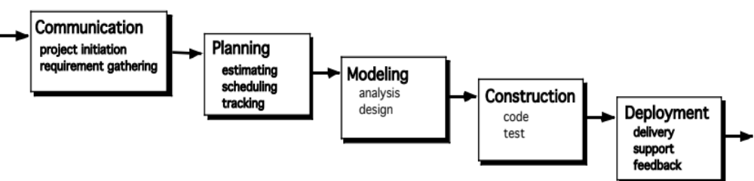
The Waterfall Model
It is the oldest paradigm for SE. When requirements are well defined and reasonably stable, it leads to a linear fashion.
The classic life cycle suggests a systematic, sequential approach to software development.

Slide 19
The Waterfall Model
Problems:
Creating a software is rarely a linear process, usually some iteration is needed.
It is hard to state all requirements explicitly.
This can lead to a Blocking state.
Code will not be released until very late.

Slide 20

The V-Model
A variation of the Waterfall Model
Depicts the relationship between quality assurance actions and the actions associated with communication, modeling and early code construction activates.

Slide 21
The V-Model
Team first moves down the left side of the V to refine the problem requirements.
Once code is generated, the team moves up the right side of the V, performing a series of tests that validate each of the models created as the team moved down the left side.

Slide 22
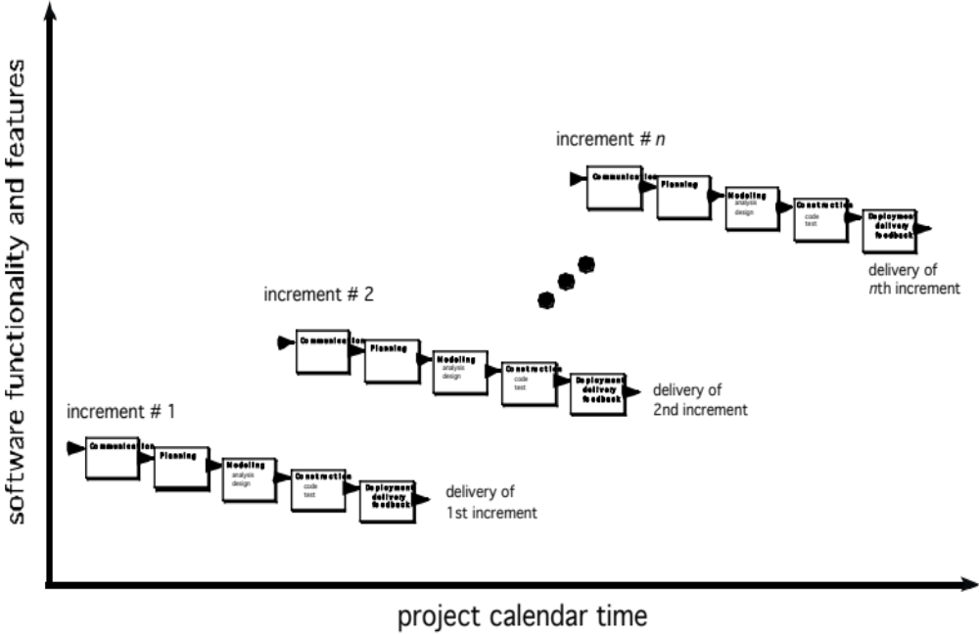
The Incremental Model

Slide 23
The Incremental Model
Properties of the Incremental Model:
Can be used when the initial requirements are reasonably well defined, but the overall scope of the development effort precludes a purely linear process.
Can also be used to expand a limited set of new functions to a later system release.
It combines elements of linear and parallel process flows.

Slide 24
The Incremental Model
Each linear sequence produces deliverable increments of the software.
The first increment is often a core product with many supplementary features. Users use it and evaluate it with more modifications to better meet the needs.

Slide 25
Evolutionary Models
Software system evolves over time as requirements often change as development proceeds. Thus, a straight line to a complete end product is not possible. However, a limited version must be delivered to meet competitive pressure.
Used when a set of core product or system requirements is well understood, but the details and extension have yet to be defined.

Slide 26
Evolutionary Models
Can be used when you need a process model that has been explicitly designed to accommodate a product that evolved over time.
It is iterative, which enables you to develop increasingly more complete version of the software.
Two types are introduced, namely Prototyping and Spiral models.

Slide 27
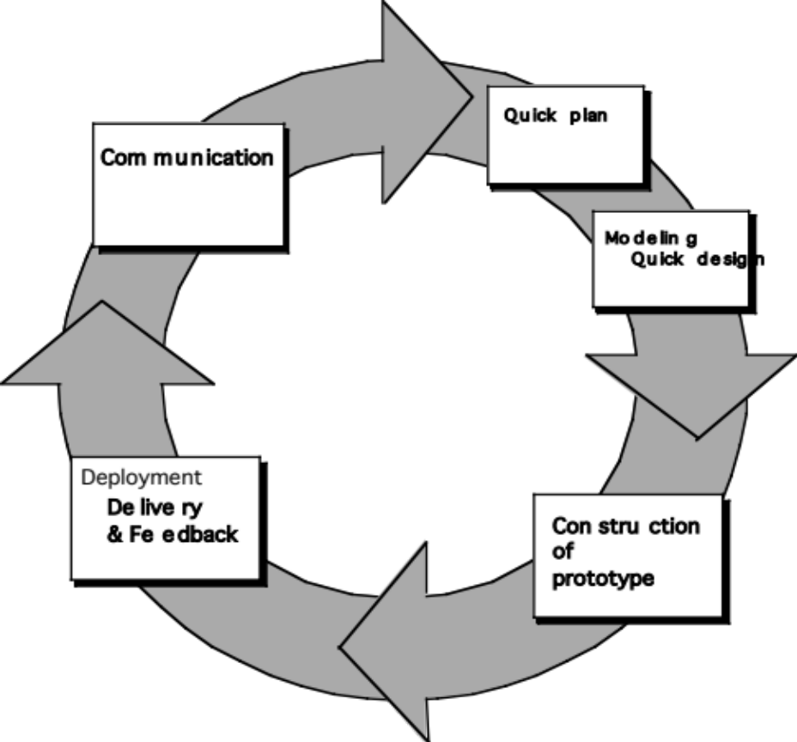
Evolutionary Models: Prototyping
Quick
plan
communication
Modeling
Quick design
Deployment
delivery &
feedback
Construction
of prototype
Construction
of prototype

Slide 28
Evolutionary Models: Prototyping
Starts with communication: Meeting with the stakeholders to define the objective, identify whatever requirements are known, and outline areas where further definition is mandatory.
A quick plan is made for prototyping and modeling (quick design).
Quick design focuses on a representation of the aspects of the software that will be visible to end users. (interface and output).
The next step is the construction of a prototype which will be deployed and evaluated.
Stakeholder’s comments will be used to refine requirements.

Slide 29
Evolutionary Models: Prototyping
When to use:
Customer defines a set of general objectives but does not identify detailed requirements for functions and features.
Developer may be unsure of the efficiency of an algorithm, or the form that human computer interactions should take.

Slide 30
Evolutionary Models: Prototyping
Both stakeholders and software engineers like the prototyping paradigm.
Users get a feel for the actual system, and developers get to build something immediately.
However, engineers may make compromises in order to get a prototype working quickly. The less-than-ideal choice may be adopted forever after you get used to it.

Slide 31
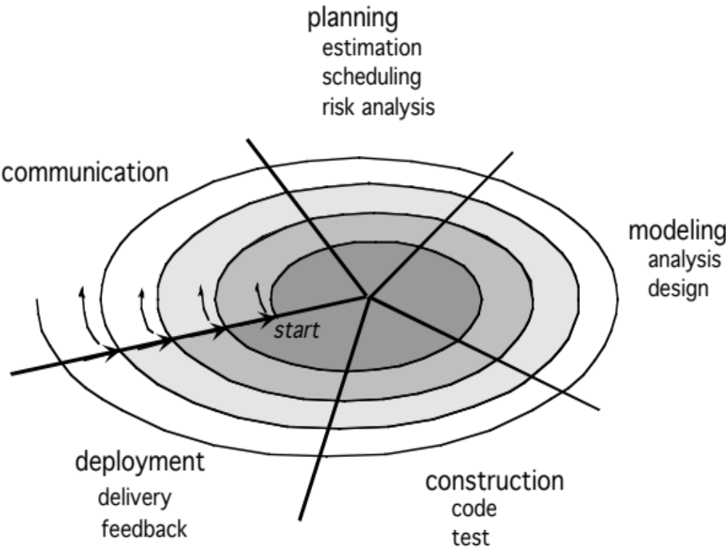
Evolutionary Models: The Spiral

Slide 32
Evolutionary Models: The Spiral
It couples the iterative nature of prototyping with the controlled and systematic aspects of the waterfall model
It is a risk-driven process model generator that is used to guide multi-stakeholder concurrent engineering of software intensive systems.
Two main distinguishing features: adopts a cyclic approach for incrementally growing a system’s degree of definition and implementation while decreasing its degree of risk. It also uses a set of anchor point milestones for ensuring stakeholder commitment to feasible and mutually satisfactory system solutions.

Slide 33
Evolutionary Models: The Spiral
A series of evolutionary releases are delivered.
During the early iterations, the releases might be models or prototypes.
During later iterations, increasingly more complete version of the engineered system are produced.
The first circuit in the clockwise direction might result in the product specification

Slide 34
Evolutionary Models: The Spiral
Subsequent passes around the spiral might be used to develop a prototype and then progressively more sophisticated versions of the software.
Each pass results in adjustments to the project plan.
Cost and schedule are adjusted based on feedback.
The number of iterations will be adjusted by project manager.

Slide 35
Problems of Evolutionary Processes
Variable number of cycles required to construct the end product.
It does not establish the maximum speed of evolution. If the evolution occur too fast, without a period of relaxation, it is certain that the process will fall into chaos. On the other hand, if the speed is too slow, productivity could be affected.
Software processes should be focused on flexibility and extensibility rather than on high quality. We should prioritize the speed of the development over zero defects.
Extending the development in order to reach high quality could result in a late delivery of the product when the opportunity niche has disappeared.

Slide 36
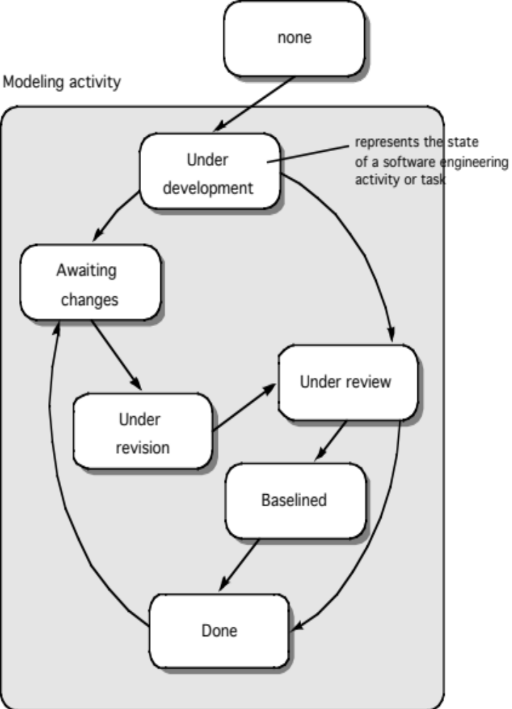
Concurrent Model

Slide 37
Concurrent Model
Allows a software team to represent iterative and concurrent elements of any of the process models. For example, the modeling activity defined for the spiral model is accomplished by invoking one or more of the following actions: prototyping, analysis and design.
Modeling may be in any one of the states at any given time. For example, communication activity has completed its first iteration and in the awaiting changes state. The modeling activity was in inactive state, now makes a transition into the under development state. If customer indicates changes in requirements, the modeling activity moves from the under development state into the awaiting changes state.

Slide 38
Concurrent Model
Concurrent modeling is applicable to all types of software development and provides an accurate picture of the current state of a project.
Rather than confining software engineering activities, actions and tasks to a sequence of events, it defines a process network.
Each activity, action or task on the network exists simultaneously with other activities, actions or tasks.
Events generated at one point trigger transitions among the states.

Slide 39
Still Other Process Models
Component based development—Used when reuse is a development objective ( like spiral model)
Formal methods—emphasize the mathematical specification of requirements (easy to discover and eliminate ambiguity, incompleteness and inconsistency)
Aspect Oriented software development (AOSD)—provides a process and methodological approach for defining, specifying, designing, and constructing aspects

Slide 40
Still Other Process Models
Unified Process—a “use-case driven, architecture-centric, iterative and incremental” software process closely aligned with the Unified Modeling Language (UML) to model and develop object-oriented system iteratively and incrementally.

Slide 41

The Unified Process (UP)
elaboration
inception

Slide 42
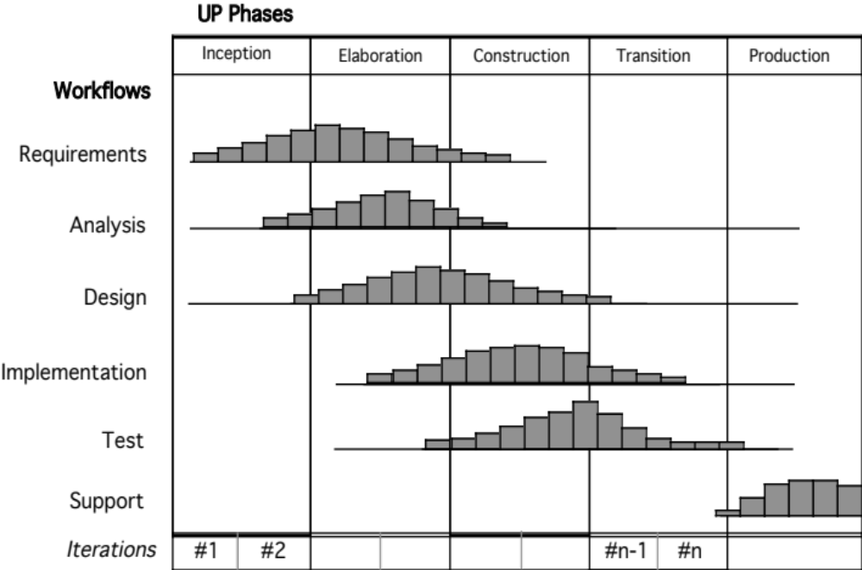
UP Phases

Slide 43
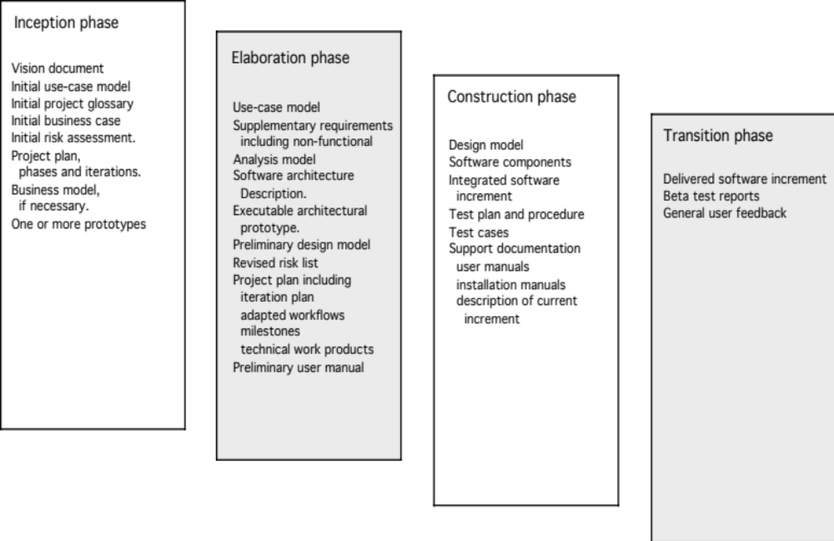
UP Work Products

Slide 44
Personal Software Process (PSP)
Planning. This activity isolates requirements and develops both size and resource estimates. In addition, a defect estimate (the number of defects projected for the work) is made. All metrics are recorded on worksheets or templates. Finally, development tasks are identified and a project schedule is created.
High-level design. External specifications for each component to be constructed are developed and a component design is created. Prototypes are built when uncertainty exists. All issues are recorded and tracked.
High-level design review. Formal verification methods are applied to uncover errors in the design. Metrics are maintained for all important tasks and work results.
Development. The component level design is refined and reviewed. Code is generated, reviewed, compiled, and tested. Metrics are maintained for all important tasks and work results.
Postmortem. Using the measures and metrics collected (this is a substantial amount of data that should be analyzed statistically), the effectiveness of the process is determined. Measures and metrics should provide guidance for modifying the process to improve its effectiveness.

Slide 45
Team Software Process (TSP)
Builds self-directed teams that plan and track their work, establish goals, and own their processes and plans. These can be pure software teams or integrated product teams (IPT) of three to about 20 engineers.
Shows managers how to coach and motivate their teams and how to help them sustain peak performance.
Accelerates software process improvement by making CMM Level 5 behavior normal and expected.
  The Capability Maturity Model (CMM), a measure of the effectiveness of a software process, is discussed in Chapter 30.
Provides improvement guidance to high-maturity organizations.
Facilitates teaching the teammates industrial-grade team skills.

